Slide 1
IMPORTANCE OF SCIENCE IN ROUTINE
- BY NANDINI SEDANI

Slide 2
What is science?
Science is that thing which makes your life more easy and comfortable.
Science is nothing but a connection between human and technology.

Slide 3
How science is related to our routine life?
From the starting of the day of our life to ending, we are totally depending or related with science.
Lets see it one by one,
At the morning we get up, we do brush, that brush and toothpaste is invention of science.
After that we go to take bath, that bathtub and toilet seat is invention of science.

Slide 4
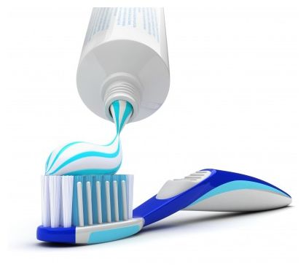
Continue..

Slide 5
Continue..
Then we have our break-fast, that break-fast is made over stove, that stove is invention of science.
Every instrument of kitchen like, grinder, mixture, refrigerator, etc…

Slide 6
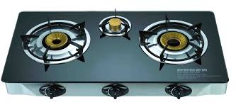
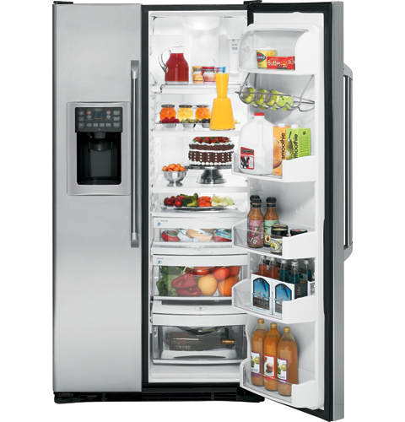

Slide 7
Continue…
Then we use vehicles like cars, bikes, cycle.
We also use cell-phone, computer, fax, etc..
We use tube lights, in kitchen we use water purifier, etc….

Slide 8
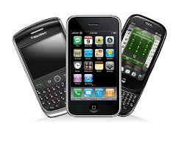
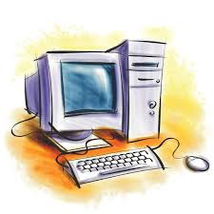

Slide 10
All this things are invention or say part of science.
Also our house, medicines, etc…
By this way science is related with us.
We are living in the world of science.

Slide 11
-:Thank you:-

